Slide 1

Notes:
N =
Root
2

Slide 2

Travelling Salesman Problem
Notes:
Section End/Start
Use this at section’s start or end. For example: “Questions” or “Time for Practice”. To be used for Impacts (get the student’s attention).

Slide 3
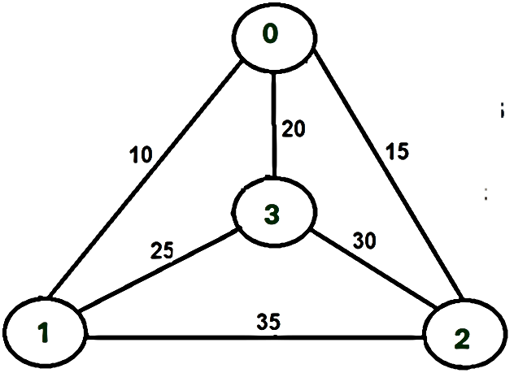

Travelling Salesman Problem
Given a set of cities and distance between every pair of cities, the problem is to find the shortest possible tour that visits every city exactly once and returns to the starting point.
Notes:
Title + Text

Slide 4
Travelling Salesman Problem
Input Format:
First input corresponds to an integer N - which points to number of vertices in the graph.
Second input corresponds to set of integers in the given matrix format - which points to the adjacency matrix representation.
Output format:
The first line corresponds to an integer which represents the minimum cost.
The second line corresponds to the set of integers which denotes the path taken.
Sample Output
The cost list is :
0 1 1
1 0 0
2 1 1
The Path is:
1--->2--->1
Minimum cost is 2
Sample Input
3
0 1 1
1 0 0
2 1 1
Notes:
Title + Text

Slide 5

import java.util.*;
class Main{
static int ary[][]=new int[10][10];
static int completed[]=new int[10];
static int n,cost=0;
public static int least(int c){
int i,nc=999;
int min=999,kmin=0;
for(i=0;i < n;i++){
if((ary[c][i]!=0)&&(completed[i]==0))
if(ary[c][i]+ary[i][c] < min)
{
min=ary[i][0]+ary[c][i];
kmin=ary[c][i];
nc=i;
}
}
if(min!=999)
cost+=kmin;
return nc;
}
1
2
3
4
5
6
7
8
9
10
11
12
13
14
15
16
17
18
19
20
21
22

Slide 6
public static void takeInput(int n, int[][] ary){
int i,j;
if(n == 0 || n == 1)
System.out.print("Path doesn't exist");
else{
for(i=0;i<n;i++)
completed[i]=0;
System.out.print("The cost list is :");
for( i=0;i<n;i++){
System.out.print("\n");
for(j=0;j<n;j++)
System.out.printf("%d ",ary[i][j]);
}
}
}
public static void mincost(int city){
int i,ncity;
completed[city]=1;
System.out.printf("%d--->",city+1);
23
24
25
26
27
28
29
30
31
32
33
34
35
36
37
38
39
40
41
42
43
44

Slide 7
ncity=least(city);
if(ncity==999){
ncity=0;
System.out.printf("%d",ncity+1);
cost+=ary[city][ncity];
return;
}
mincost(ncity);
}
public static void main(String[] args){
Scanner s=new Scanner(System.in);
n=s.nextInt();
for(int i=0;i<n;i++)
for(int j=0;j<n;j++)
ary[i][j]=s.nextInt();
takeInput(n,ary);
System.out.print("\nThe Path is:\n");
mincost(0);
System.out.printf("\nMinimum cost is %d ",cost);
}
}
45
46
47
48
49
50
51
52
53
54
55
56
57
58
59
60
61
62
63
64
65
66

Slide 8

THANK YOU
Notes:
Thank you slide

